Slide 1
Computer Architecture (Fall 2021)
Lecture 7
Instruction Set Principles
Dr. Yujuan Tan (谭玉娟)
Office: Main Building 0626
Email: tanyujuan@cqu.edu.cn

Slide 2
MIPS
• 1981: Stanford MIPS Computer, a “Microprocessor without
Interlocked Pipeline Stages” [Hennessy81]
– no HW to stall the pipeline (handling dependencies is compiler’s job)
• 1984: Hennessy founds MIPS Computer System
– R2000 & R3000 first products ( with interlock in HW! )
• 1991: MIPS releases the 64-bit R4000
– SGI buys MIPS which becomes the division MIPS Technologies
• 1999: MIPS-Technologies so successful that SGI spins off it
– two products MIPS32, MIPS64
– major revenues portion from licensing the design
– estimated 1/3 of the produced RISCs is a MIPS-based design
• almost 100 million of MIPS manufactured in 2002
• Used in products from ATI Technologies, Broadcom, Cisco, NEC, Nintendo
SGI, Sony, Texas Instruments, Toshiba…
• MIPS64 is used throughout the textbook to illustrate the ILP techniques

Slide 3
Before Introducing MIPS64: What We Expect?
• Architecture?
– register-to-register (load-store)
• Registers?
– “many” general purpose registers and dedicated FP registers
• Addressing modes support?
– displacement (address-offset of 12 to 16 bits)
– using PC-relative addressing, branch +/- 2^15 words from PC
– immediate (size 8-16 bits)
– register indirect
• Data sizes & types?
– Integers (8,16,32,64 size) and FP (64)
• Instructions types?
– strong support for simple pervasive instructions
• load, store, add, sub, move register-register, and shift
• compare equal/not equal/less, branch, jump, call, return
• Encoding?
– fixed for performance rather than variable for code size

Slide 4
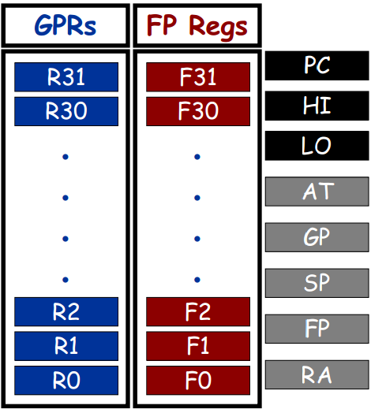
MIPS - Registers
• 32 64-bit GPRs
– R0 is hardwired to zero
– AT, GP, SP, FP, RA are
conventionally mapped to
R1, R28, R29, R30, R31
• 32 Floating Point
Registers holding either
– 32 single-precision values (32 bits)
• half of the FPR is not used
– 32 double-precision values (64 bits)
• Special registers
– PC – program counter
– HI, LO
• integer multiply result
(higher and lower word)
• integer divide result
(remainder and quotient)

Slide 5
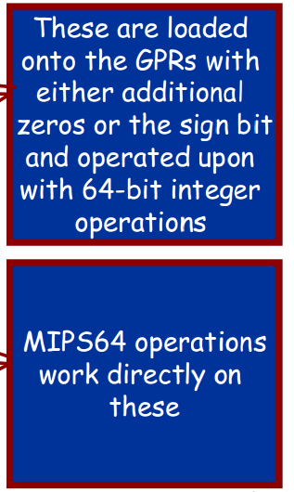
MIPS – Data Types
• Integer data
– 8-bit bytes
– 16-bit half words
• present in C and popular in
programs like operating systems
(concerned about size of data
structures)
• also even more popular if Unicode
becomes more pervasive
– 32-bit words
– 64-bit double words
• Floating Point
– 32-bit single precision
• Same motivations as for the 16-bit
half words
– 64-bit double precision

Slide 6
MIPS – Addressing Modes
• The hardware only support two addressing modes
– immediate (16-bit)
DADDI R3, R2, #7 ; Regs[R3] ←Regs[R2] + 7
– displacement (16-bit)
LD R3, 100(R1) ; Regs[R3] ←Mem[100+Regs[R1]]
• Two other modes supported “indirectly”
– register indirect (placing 0 in the 16-bit displacement
field)
LD R3, 0(R1) ; Regs[R3] ←Mem[Regs[R1]]
– direct addressing (using 0 as the base register)
LD R3, 1001(R0) ; Regs[R3] ←Mem[1001]
• Memory is byte-addressable with a 64-bit address

Slide 7
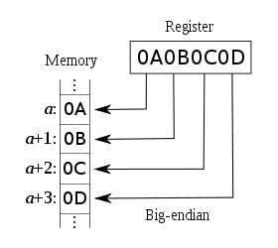
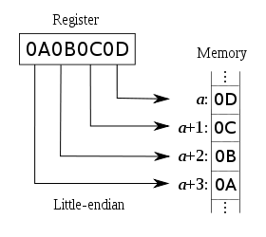
Interpreting Memory Addresses
• Memory word is addressed by the byte at the lowest address
• Big Endian
– Most significant byte is
at the lowest address
• “big end first”
• Ex: Motorola 68000,
SPARC, IBM 360
• Little Endian
– Least significant byte is
at the lowest address
• “little end first”
• Ex: Intel x86, AMD64, VAX
Some architectures can be configured in both ways: ARM, MIPS, IA64, PowerPC

Slide 8



MIPS – Instruction Format and Layout
MIPS instructions fall into 5 classes:
Arithmetic/logical/shift/comparison
Control instructions (branch and jump)
Load/store
Other (exception, register movement to/from GP registers, etc.)
Three instruction encoding formats:
R-type (6-bit opcode, 5-bit rs, 5-bit rt, 5-bit rd, 5-bit shamt, 6-bit function code)
I-type (6-bit opcode, 5-bit rs, 5-bit rt, 16-bit immediate)
J-type (6-bit opcode, 26-bit pseudo-direct address)

Slide 9
Example Instructions
ADD $2, $3, $4
R-type A/L/S/C instruction
Opcode is 0’s, rd=2, rs=3, rt=4, func=000010
000000 00011 00100 00010 00000 000010
JALR $3
R-type jump instruction
Opcode is 0’s, rs=3, rt=0, rd=31 (by default), func=001001
000000 00011 00000 11111 00000 001001
ADDI $2, $3, 12
I-type A/L/S/C instruction
Opcode is 001000, rs=3, rt=2, imm=12
001000 00011 00010 0000000000001100

Slide 10
Example Instructions
BEQ $3, $4, 4
I-type conditional branch instruction
Opcode is 000100, rs=00011, rt=00100, imm=4 (skips next 4 instructions)
000100 00011 00100 0000000000000100
SW $2, 128($3)
I-type memory address instruction
Opcode is 101011, rs=00011, rt=00010, imm=0000000010000000
101011 00011 00010 0000000010000000
J 128
J-type pseudodirect jump instruction
Opcode is 000010, 26-bit pseudodirect address is 128/4 = 32
000010 00000000000000000000100000

Slide 11
MIPS – Some Load & Store Instructions
• Load Double Word
LD R1, 30(R2) ;Regs[R1] ←₆₄ Mem[30 + Regs[R2]]
• Load Double Word (direct addressing using zero as base reg)
LD R1, 30(R0) ;Regs[R1] ←₆₄ Mem[30 + 0]
• Load Byte
LB R1, 40(R3) ;Regs[R1]←₆₄ (Mem[40 + Regs[R3]]₀) ⁵⁶ ##
Mem[40 + Regs[R3]]
• Load Byte Unsigned
LBU R1, 40(R3) ;Regs[R1] ←₆₄ 0⁵⁶ ## Mem[40 + Regs[R3]]
• Load FP single
L.S F0, 50(R3) ;Regs[F0] ←₆₄ Mem[50 + Regs[R3]] ## 0³²
• Load FP double
L.D F0, 50(R2) ;Regs[F0] ←₆₄ Mem[50 + Regs[R2]]
• Store Half Word
SH R3, 502(R2) ;Mem[502 + Regs[R2]] ←₁₆ Regs[R3]_{48..63}
• Store FP single
S.D F0, 40(R3) ;Mem[40 + Regs[R3] ←₃₂ Regs[F0]]_{0..31}

Slide 12
MIPS – Some Arithmetic/Logic Instructions
• Double Word Add
DADD R1, R2, R3 ;Regs[R1] ← Regs[R2] + Regs[R3]
• Double Word Add Immediate Unsigned
DADDIU R1, R2, #3 ;Regs[R1] ← Regs[R2] + 3
• Double Word Shift Left Logical
DSLL R1, R2, #5 ;Regs[R1] ← Regs[R2] << 5
• Set on Less Than
SLT R1, R2, R3 ; if (Regs[R2] < Regs[R3])
Regs[R1] ← 1 else Regs[R1] ← 0
• Multiply and Add Word to HI,LO registers
MADD R1, R2 ; (LO,HI) ← Regs[R1] x Regs[R2] + (LO,HI)
• Loading a Constant (mnemonic: LI)
LI R1, #3 ;Regs[R1] ← 3
• Register-Register Move (mnemonic: MOV)
MOV R1,R2 ;Regs[R1] ← Regs[R2]

Slide 13
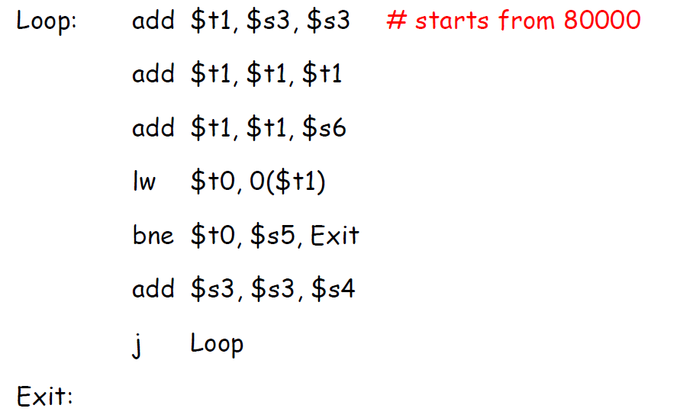
EXAMPLE

Slide 14
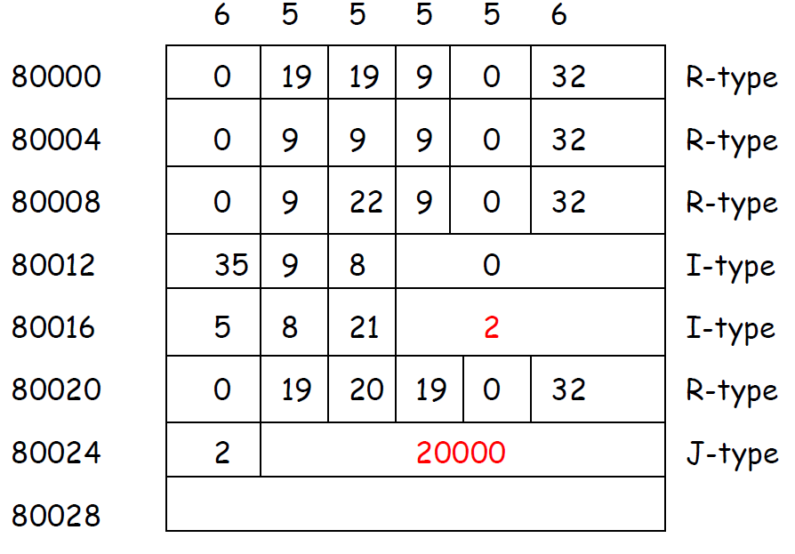
EXAMPLE

Slide 15
MIPS – Some Arithmetic/Logic Instructions
• Suppose register R3 has the binary number
1111 1111 1111 1111 1111 1111 1111 1111
• and register R4 has the binary number
0000 0000 0000 0000 0000 0000 0000 0001
• What are the values of R1 and R2 after this?
SLT R1 R3 R4
SLTU R2 R3 R4
• Answer:
R1 = 1, R2 = 0
• because
R3 = -1 (as an integer) and =4,294,967,295 (as unsigned)
R4 = 1 in both cases

Slide 16
MIPS – Some Control-Flow Instructions
• Jump (28-bit target address is 26-bit name shifted left twice)
J name ;PC ← PC_{64..28} ## name ## 0²
• Jump and link (using the return address register RA≡R31)
JAL name ;Regs[R31] ← PC+8; PC ← PC_{64..28} ## name ## 0²
• Jump and link register
JALR R2 ;Regs[R31] ← PC+8; PC ← Regs[R2]
• Jump register
JR R3 ;PC ← Regs[R3]
• Branch equal (zero) (compilers combined this with SLT,
SLTI in order to build branch-on-less conditions)
BEQ R4, R0, name ;if (Regs[R4]==0) PC ← PC + signExt{name ## 0² }
• Branch not equal
BNE R3,R4,name ;if(Regs[R3]!= Regs[R4]) PC ← PC + signExt{name ## 0² }
• Conditional move if zero (support conversion of a simple
branch into a conditional arithmetic instruction)
MOVZ R1,R2,R3 ;if(Regs[R3]==0) Regs[R1] ← Regs[R2]

Slide 17
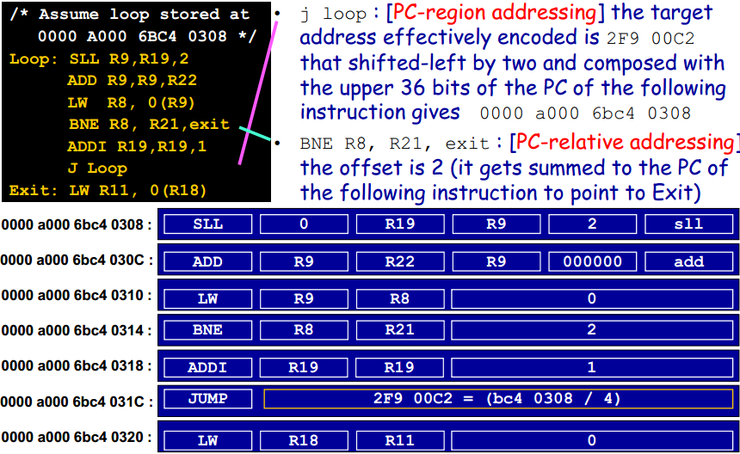
Review: MIPS-Jump Instruction Example

Slide 18
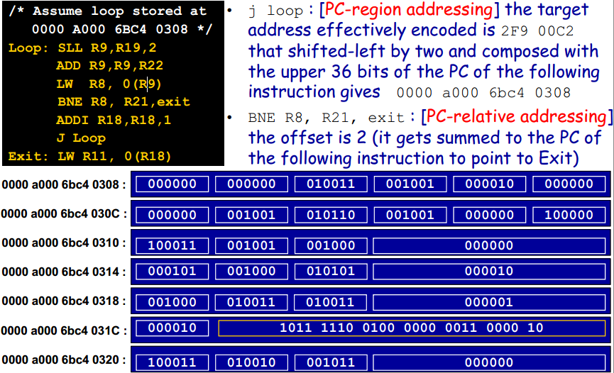
Review: MIPS-Jump Instruction Example

Slide 19
MIPS – Floating-Point Instructions
• Floating Point Absolute Value (Double Precision)
ABS.D F1, F2 ;F1 ← abs(F2)
• Floating Point Add (Single Precision)
ADD.S F3, F1, F2 ;Regs[F3] ← Regs[F1] + Regs[F2]
• Floating Point Add (Double Precision)
ADD.D F3, F1, F2 ;Regs[F3] ← Regs[F1] + Regs[F2]
• Floating Point Divide (Double Precision)
DIV.D F3, F1, F2 ;Regs[F3] ← Regs[F1] / Regs[F2]
• Floating Point Square Root (Double Precision)
SQRT.D F3, F1 ;Regs[F3] ← sqrt(Regs[F1])
• Floating Point Multiply Add (Single Precision)
MADD.S F3, F1, F2, F4 ;Regs[F3] ←(Regs[F2] x Regs[F4)] +
+ Regs[F1]

Slide 20
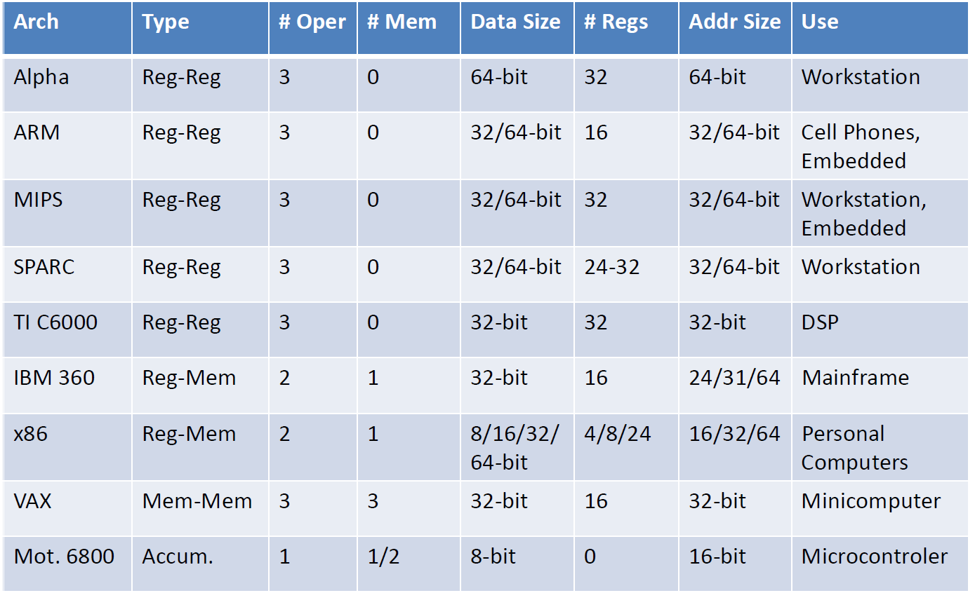
Real World Instruction Sets

Slide 21
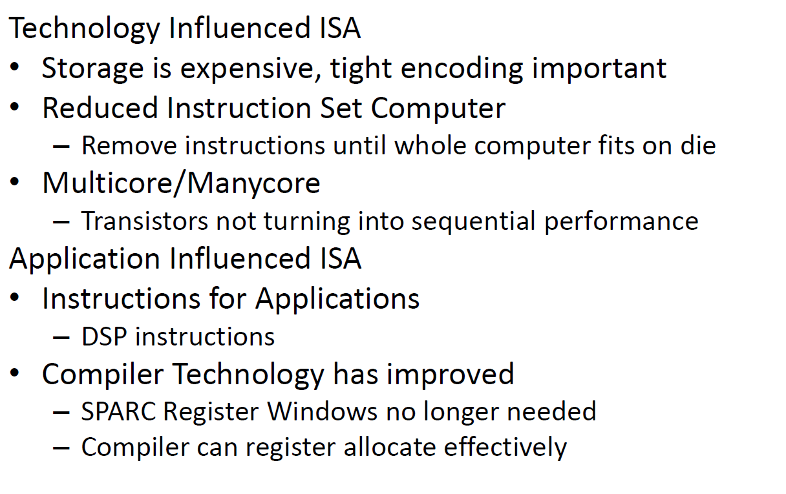
Why the Diversity in ISAs?
Notes:
技术影响ISA
--存储是昂贵的，紧凑的编码非常重要
--精简指令集计算机
----删除指令，直到整个计算机安装到模具上
--多芯/多芯
----晶体管没有转变为连续性能
应用影响ISA
--申请须知
----DSP指令
--编译器技术得到了改进
----SPARC注册窗口不再需要
----编译器可以有效地注册分配

Slide 22
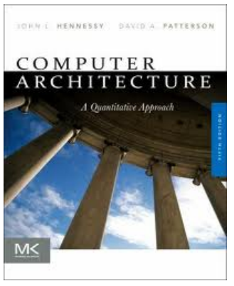
Assigned Readings
• Computer Architecture – A
Quantitative Approach by
John Hennessy
– Stanford University
Dave Patterson
– UC Berkeley
Fifth Edition - 2012
Morgan Kaufmann (Elsevier)
• Read Sections
Appendix A.1-A.7, A.9-A.11

Slide 23
Homework #2
H&P 5th
Page A-47: A.3, A.7（b小题不做要求）, A.9
Due 2021/10/26

